Slide 1
Intro to Cloud Computing CS4037 (BCS-6A) Lecture 14
Danyal Farhat
FAST School of Computing
NUCES Lahore

Slide 2
Module 7: Storage
AWS Academy Cloud Foundations

Slide 3
Section 3: Amazon Elastic File System (Amazon EFS)
Module 7: Storage

Slide 4

Amazon Elastic File System
Amazon EFS implements storage for EC2 instances that multiple virtual machines can access at the same time.
It is implemented as a shared file system that uses the Network File System (NFS) protocol.
Amazon Elastic File System (Amazon EFS)
Notes:
In private subnet or publically accessible.

Slide 5
Amazon EFS features
Fully managed file storage system in the AWS Cloud
Works well for big data and analytics, media processing workflows, content management, web serving, and home directories
Petabyte-scale, low-latency file system
Shared storage
Elastic capacity
Supports Network File System (NFS) versions 4.0 and 4.1 (NFSv4)
Compatible with all Linux-based AMIs for Amazon EC2

Slide 6


Amazon EFS architecture
VPC
Availability Zone A
Availability Zone B
Availability Zone C
Private subnet
Private subnet
Private subnet
Network Interface
Network Interface
Network Interface
Private subnet
Network Interface
Network Interface
Network Interface
Mount target
Mount target
Mount target
Elastic File System
Notes:
In the diagram, the VPC has three Availability Zones, and each Availability Zone has one mount target that was created in it. We recommend that you access the file system from a mount target within the same Availability Zone. One of the Availability Zones has two subnets. However, a mount target is created in only one of the subnets.

Slide 7
Amazon EFS implementation
1
Create your Amazon EC2 resources and launch your Amazon EC2 instance.
Create your Amazon EFS file system.
Create your mount targets in the appropriate subnets.
Connect your Amazon EC2 instances to the mount targets.
Verify the resources and protection of your AWS account.
2
3
4
5

Slide 8

Amazon EFS resources
File system
Mount target
Subnet ID
Security groups
One or more per file system
Create in a VPC subnet
One per Availability Zone
Must be in the same VPC
Tags
Key-value pairs

Slide 9
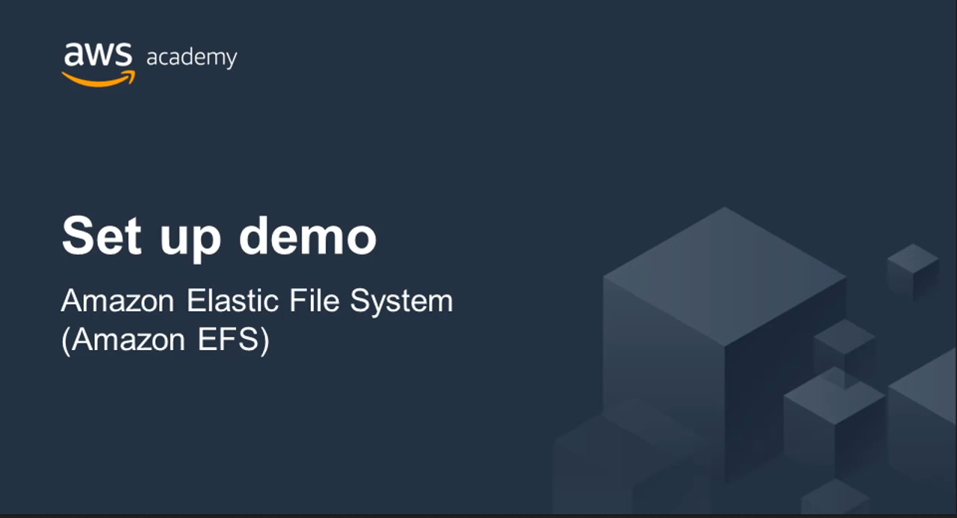
Recorded demo: Amazon Elastic File System

Slide 10

Section 3 key takeaways
Amazon EFS provides file storage over a network.
Perfect for big data and analytics, media processing workflows, content management, web serving, and home directories.
Fully managed service that eliminates storage administration tasks.
Accessible from the console, an API, or the CLI.
Scales up or down as files are added or removed and you pay for what you use.

Slide 11
Section 4: Amazon S3 Glacier
Module 7: Storage

Slide 12

Amazon S3 Glacier review
Amazon S3 Glacier is a data archiving service that is designed for security, durability, and an extremely low cost.
Amazon S3 Glacier is designed to provide 11 9s of durability for objects.
It supports the encryption of data in transit and at rest through Secure Sockets Layer (SSL) or Transport Layer Security (TLS).
The Vault Lock feature enforces compliance through a policy.
Vault – A container for storing archives.
Amazon S3 Glacier

Slide 13



Amazon S3 Glacier
Storage service for low-cost data archiving and long-term backup
You can configure lifecycle archiving of Amazon S3 content to Amazon S3 Glacier
Retrieval options –
Standard: 3–5 hours
Bulk: 5–12 hours
Expedited: 1–5 minutes
Archive after 30 days
Delete after 5 years
Amazon S3 bucket
Amazon S3 Glacier Archive

Slide 14






Amazon S3 Glacier use cases
Media asset archiving
Healthcare information archiving
Regulatory and compliance archiving
Scientific data archiving
Digital preservation
Magnetic tape replacement

Slide 15
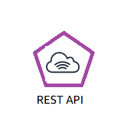


Using Amazon S3 Glacier
RESTful
web services
Java or .NET SDKs
Amazon S3 with lifecycle policies

Slide 16


Lifecycle policies
Amazon S3 lifecycle policies enable you to delete or move objects based on age.
Amazon S3 Standard
Amazon S3 Standard - Infrequent Access
Amazon
S3 Glacier
Delete
30 days
60 days
365 days
Preview2.mp4
Preview2.mp4
Preview2.mp4

Slide 17
Storage comparison
 | Amazon S3 | Amazon S3 Glacier
Data Volume | No limit | No limit
Average Latency | ms | minutes/hours
Item Size | 5 TB maximum | 40 TB maximum
Cost/GB per Month | Higher cost | Lower cost
Billed Requests | PUT, COPY, POST, LIST, and GET | UPLOAD and retrieval
Retrieval Pricing | ¢ Per request | ¢¢ Per request and per GB

Slide 18

Security with Amazon S3 Glacier
Control access with IAM
Amazon S3 Glacier encrypts your data with AES-256
Amazon S3 Glacier
Amazon S3 Glacier manages your keys for you

Slide 19

Recorded demo: Amazon S3 Glacier

Slide 20
Section 4 key takeaways
Amazon S3 Glacier is a data archiving service that is designed for security, durability, and an extremely low cost.
Amazon S3 Glacier pricing is based on Region.
Its extremely low-cost design works well for long-term archiving.
The service is designed to provide 11 9s of durability for objects.

Slide 21
Module wrap-up
Module 7: Storage

Slide 22
Module summary
In summary, in this module, you learned how to:
Identify the different types of storage
Explain Amazon S3
Identify the functionality in Amazon S3
Explain Amazon EBS
Identify the functionality in Amazon EBS
Perform functions in Amazon EBS to build an Amazon EC2 storage solution
Explain Amazon EFS
Identify the functionality in Amazon EFS
Explain Amazon S3 Glacier
Identify the functionality in Amazon S3 Glacier
Differentiate between Amazon EBS, Amazon S3, Amazon EFS, and Amazon S3 Glacier

Slide 23
Additional resources
AWS Storage page: https://aws.amazon.com/products/storage/
Storage Overview: https://docs.aws.amazon.com/whitepapers/latest/aws-overview/storage-services.html
Recovering files from an Amazon EBS volume backup: https://aws.amazon.com/blogs/compute/recovering-files-from-an-amazon-ebs-volume-backup/
Confused by AWS Storage Options? S3, EFS, EBS Explained: https://dzone.com/articles/confused-by-aws-storage-options-s3-ebs-amp-efs-explained

Slide 24
Thank you
All trademarks are the property of their owners.

